Slide 1



Data Review in DHIS2
Introduction to DHIS2
Notes:
1

Slide 2



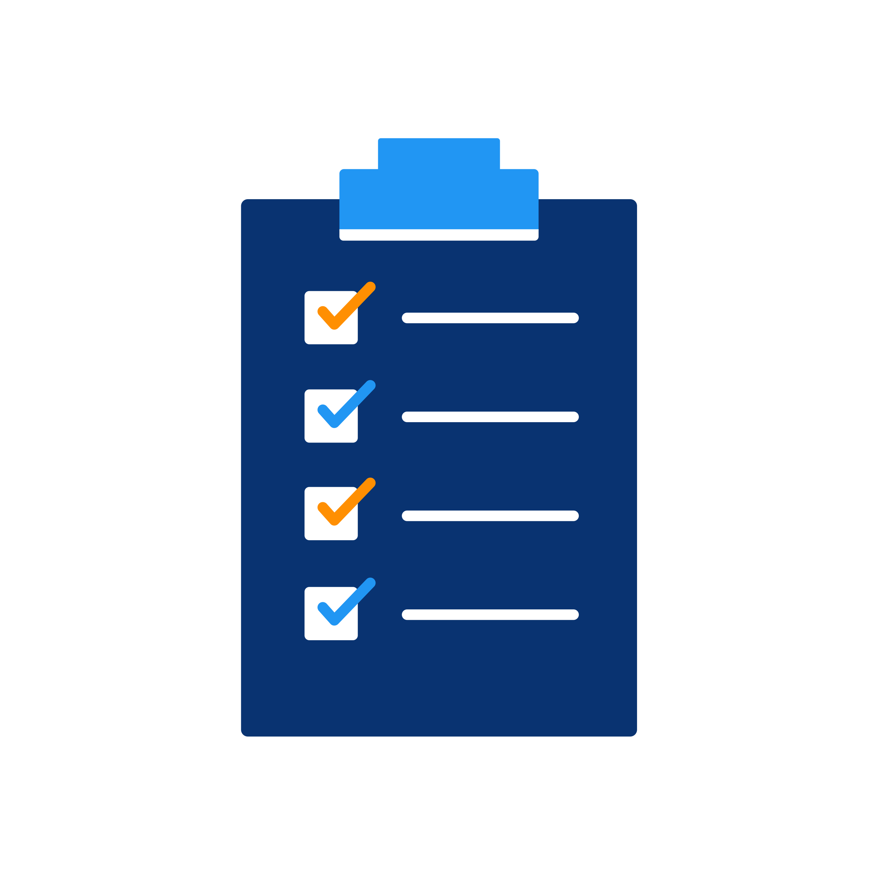



Data Entry App
Capture App
Tracker Capture App
?
Notes:
Once we have our data entered into the platform, how can we check the data’s accuracy and reliability?
2

Slide 3


In this video, you will see…
Data Quality app
Validation rule analysis
Outlier analysis
Follow-up analysis
Notes:
In this video, we will explore several tools in the DHIS2 data quality app that will help us to review and improve the quality of our data
3

Slide 4


Data quality app
Validation rule analysis
Notes:
First, in the Data Quality app, you can run a Validation rule analysis, which tests validation rules against the data registered in the system.
4

Slide 5
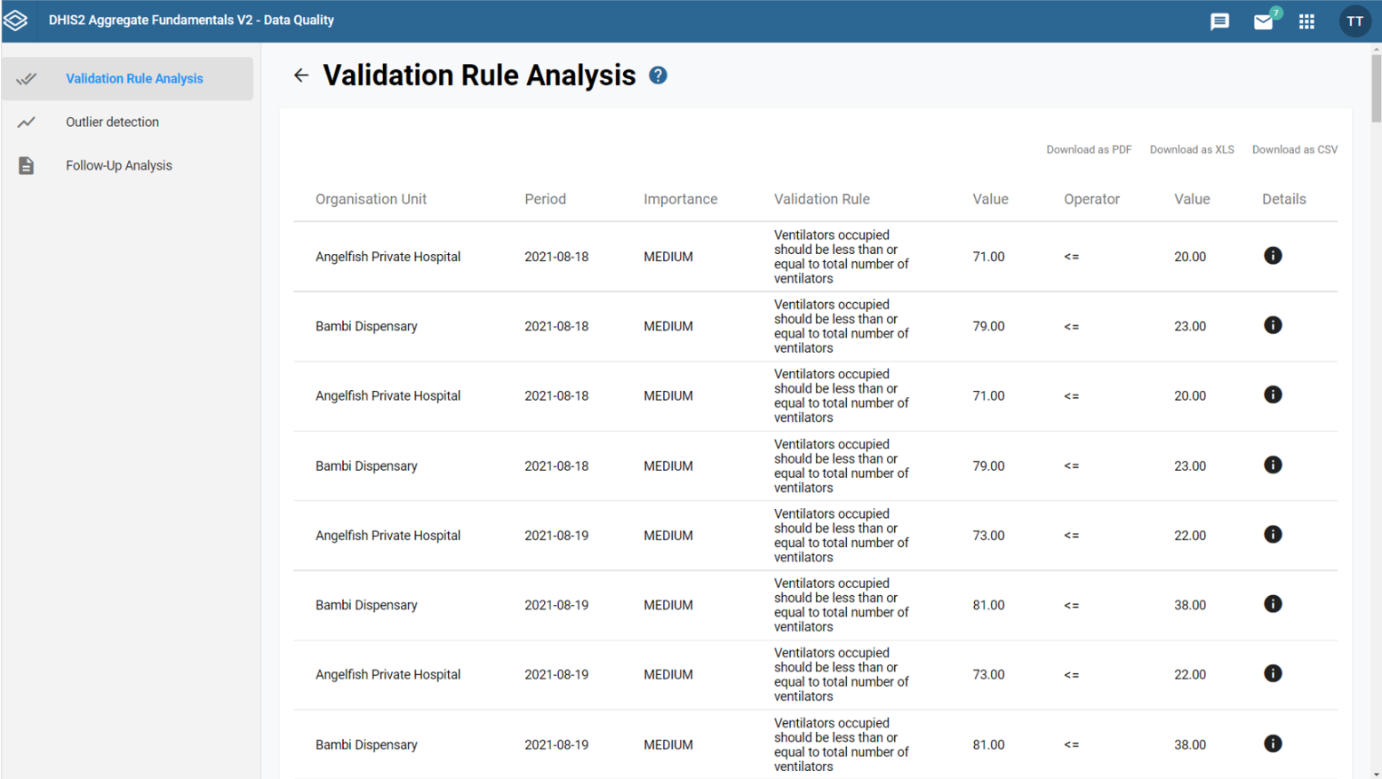
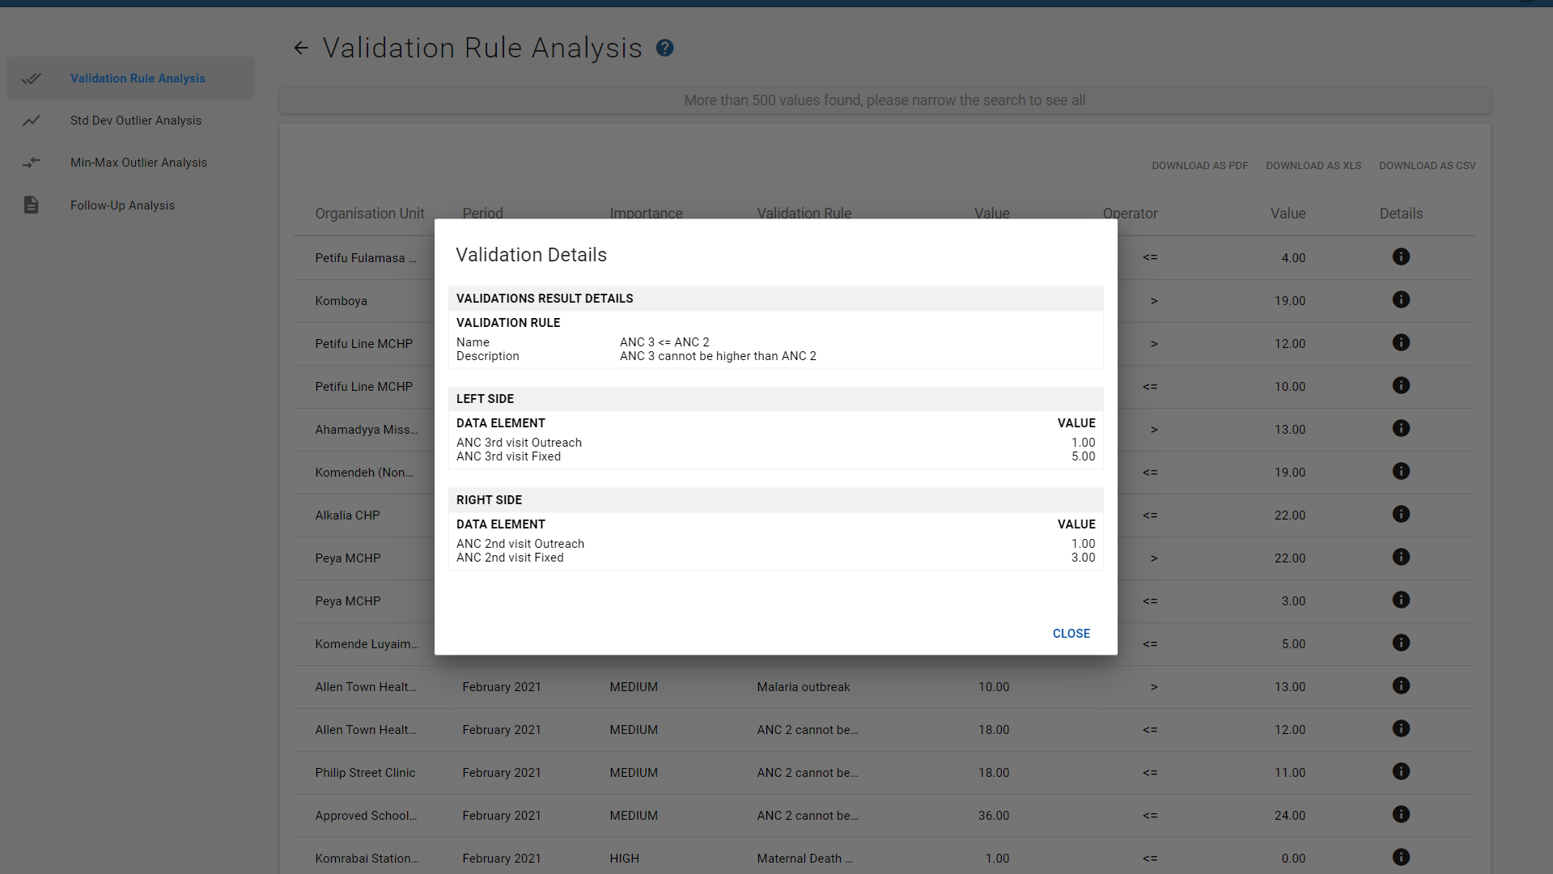

Notes:
After running the check, you will get a report with a list of data that need to be checked.
For example, if we look at the +first row, our validation rule says that +ventilators occupied should be less than or equal to the total number of ventilators.+ But the value registered for ventilators occuppied is+ 71, while the value of number of available is +20. We can follow +up with this location to determine the specific source of the error.
Note that you can also run the validation rule analysis during the data entry process.
5

Slide 6

Outlier Analysis
Outlier Analysis
Standard normal distribution
Minimum maximum values
Notes:
The out+lier analysis is another tool we can use to check data quality.
It can identify values that are potential outliers when compared to the standard normal distribution of the data under review, or it can check the data against a pre-defined minimum and maximum value range. If the data fall outside that range, it will be identified as a potential outlier.
6

Slide 7
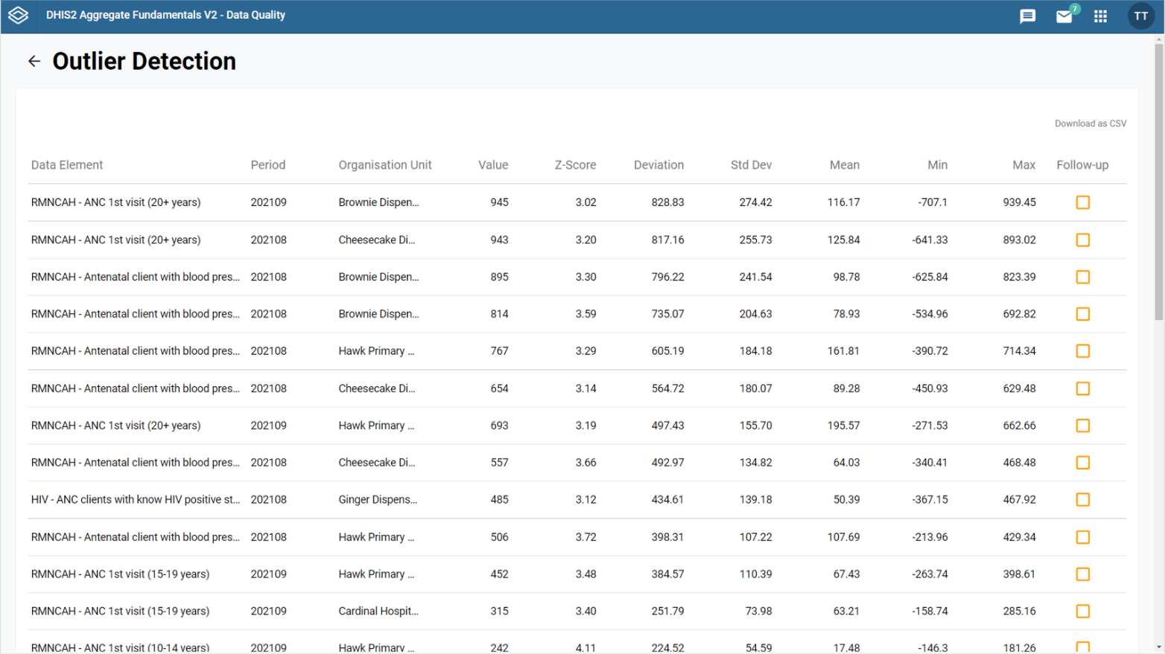

Notes:
Like in the validation rule analysis, when we run an outlier analysis, we get a report with all the data that need to be checked.
For example, in+ this row, the data indicate 767 antenatal clients had their blood pressure checked in to this health facility, and this value of 767 falls outside of the normal distribution of these data and has been identified as a potential source of error.
7

Slide 8
Follow-up analysis
Follow-up analysis
List of data values marked for follow-up
Notes:
The third and final tool available in the Data Quality App is the Follow-up analysis tool. Follow-up analysis creates a list of all data values marked for follow-up.
8

Slide 9
Follow-up analysis
List of data values marked for follow-up:
Follow-up analysis
Data entry
Data quality
Outlier analysis
Notes:
We can mark a data value for follow-up in the Data Entry app and the Data Quality app via the reports from the outlier analysis tool.
9

Slide 10
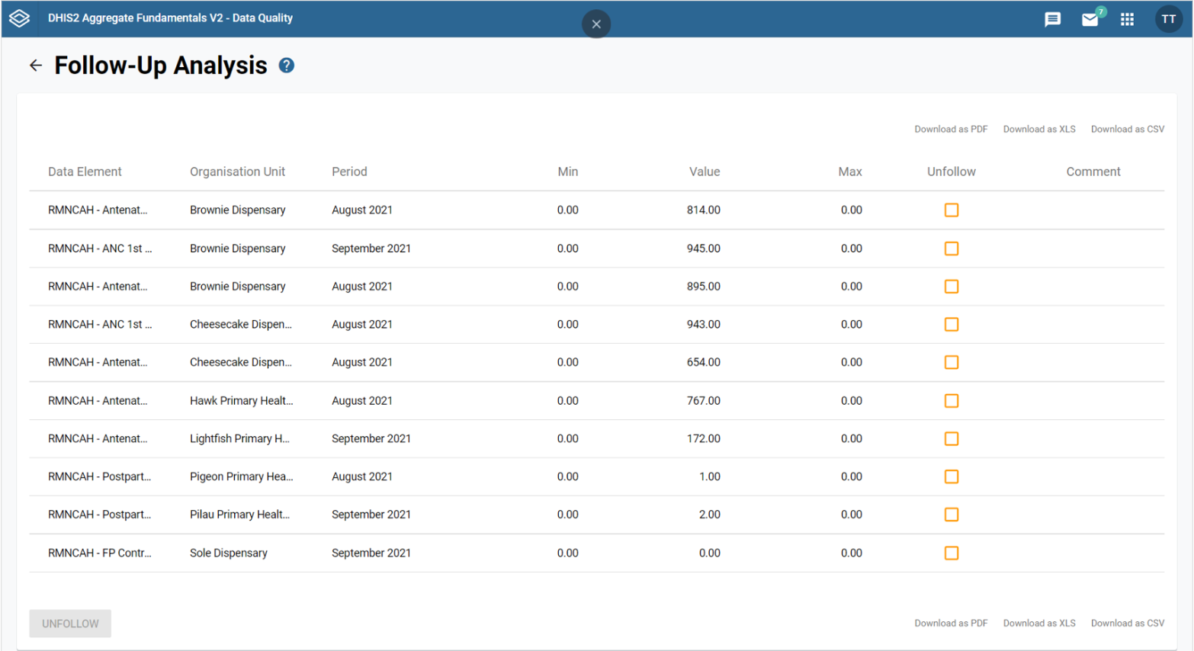
Notes:
This is an example of the report obtained after running a follow-up analysis in DHIS2.
10

Slide 11



WHO Data Quality Tool
WHO Data Quality
Review Framework
=
Notes:
In coordination with WHO, a Data Quality tool for DHIS2 has also been created. This app generates findings on data quality following WHO’s Data Quality Review Framework.
11

Slide 12
WHO Data Quality Tool
WHO Data Quality
Review Framework
Completeness
Timeliness
Internal consistency
External consistency
Notes:
This includes completeness, that is, if all the expected data are recorded;
timeliness, or if the data was received on time,
internal consistency, which compares internally submitted data with one another,
and external consistency, which compares the data with other sources such as surveys
12

Slide 13
DEMO 1
Notes:
As an example, we can review internal consistency. The WHO Data Quality tool allows us to identify outliers within our data. We can see an example of this in District C-1, where the number of Measles vaccines given in January 2020 is much higher in comparison to the other values reported within the same district in the same year.
13
DEMO

Slide 14
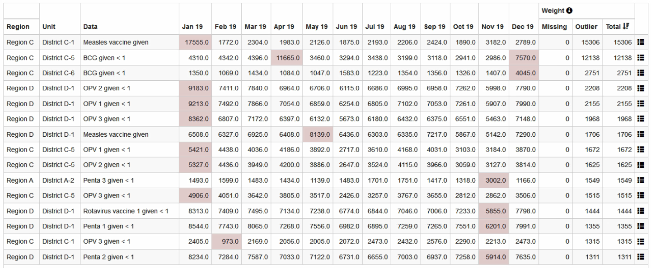
Example of internal consistency
Notes:
This helps us easily visualize what data need to be double-checked before running any analysis.
14

Slide 15
Summary
Tools in the DHIS2 Data Quality app
WHO Data Quality Tool:
Validation rules
Completeness
Outlier analysis
Timeliness
Follow-up analysis
Internal consistency
External consistency
Notes:
In summary, in DHIS2 there are several tools that help us to check the quality of the data entered, such as +validation rules, outlier analysis, and follow-up analysis.
DHIS2 and WHO have also collaborated to create a Data Quality tool that runs checks to validate completeness, timeliness, internal consistency, and external consistency.

Slide 16
Notes:
16

